Slide 1
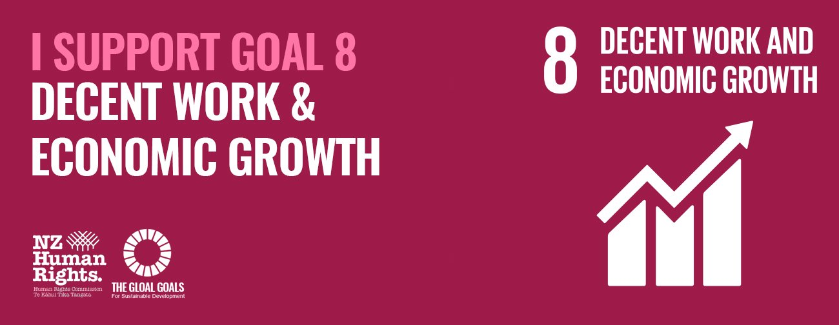
Decent Work and Economic Growth
By Valentin Ichim

Slide 2
Introduction
The Sustainable Development Goals, generally, are a call for action by all countries to promote prosperity while protecting the planet. They recognize that ending poverty must go hand-in-hand with strategies that build economic growth and address a range of social needs as education, health while tackling climate change, for example.

Slide 3
The Disoccupation
With global unemployment rates of 5,7%, in many places the ability to escape from poverty isn’t guaranteed, even though you have a work.
Roughly half the world’s population still lives on the equivalent of about $2. This slow and uneven progress requires us to rethink and retool our economic and social policies aimed at eradicating poverty.

Slide 4

What’s the Aim here?

Slide 5
To promote inclusive and sustainable economic growth, employment and decent work for all.

Slide 6
Why Decent Work and Economic Growth matter?
Sustained and inclusive economic growth can drive progress, create decent jobs for all and improve living standards.
While real GDP per capita and labour productivity have increased globally, 731 million people remain below the $1.90 poverty line.

Slide 7
Definition of Decent Work
Those opportunities for everyone to get a work which is productive and delivers a fair income, security in the workplace and social protections for families

Slide 8

How to fix this issues
Providing youth the opportunity to transition to a decent job, while investing in education and training of the highest possible quality, giving them the necessary skills that match labor market demands

